Slide 1
Sample 1: Brushite powder
Non-irradiated

Slide 2
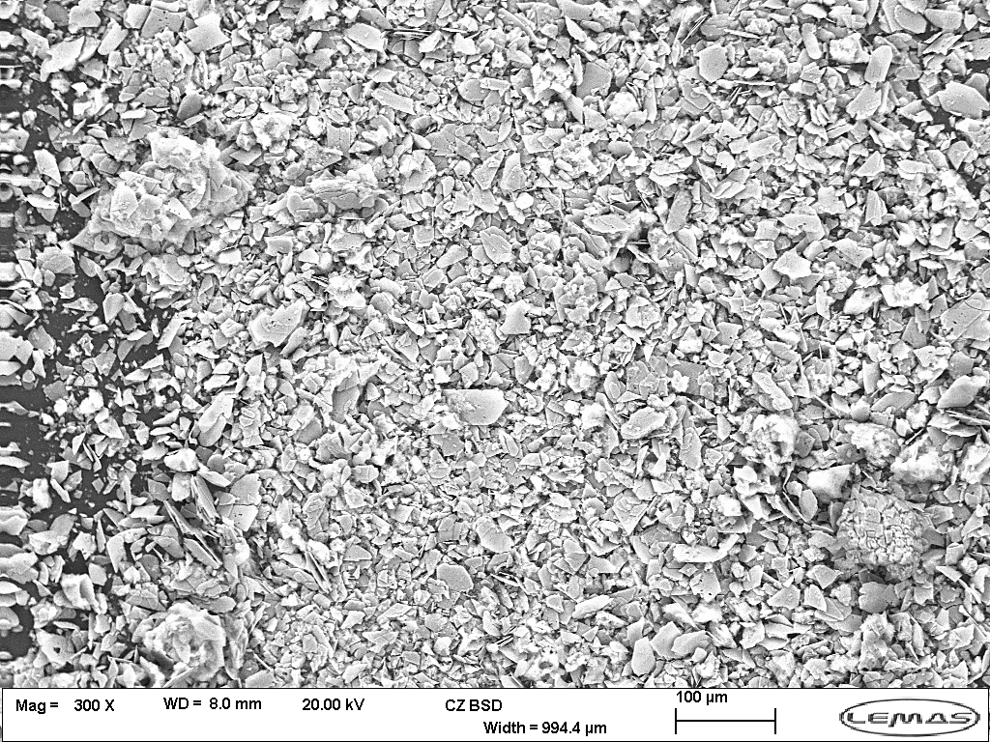

Slide 3
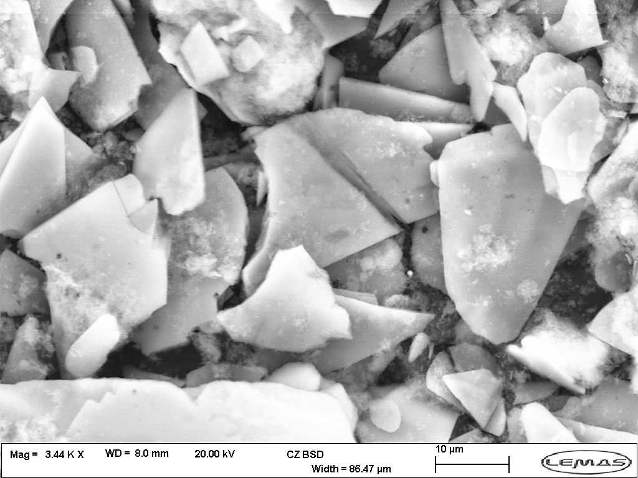

Slide 4
Sample 2: Brushite pellet
Diameter: 13 mm
Thickness: 1.08 mm
Irradiation parameters
Spot size | 30 | μm
Average power | 0.4 | W
Repetition rate | 1 | GHz
Pulse duration | 100 | fs
Wavelength | 1050 | nm

Slide 5
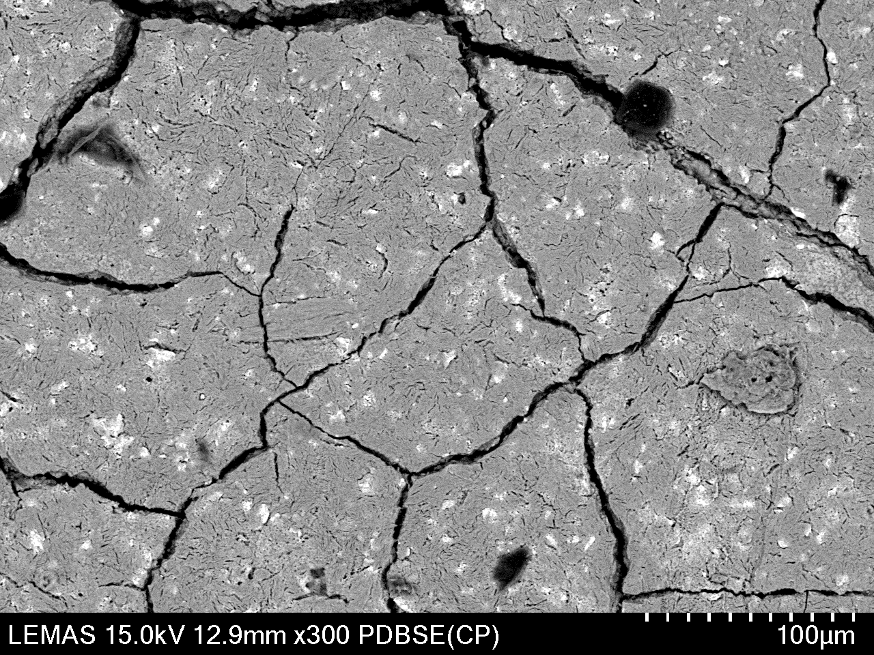

Slide 6
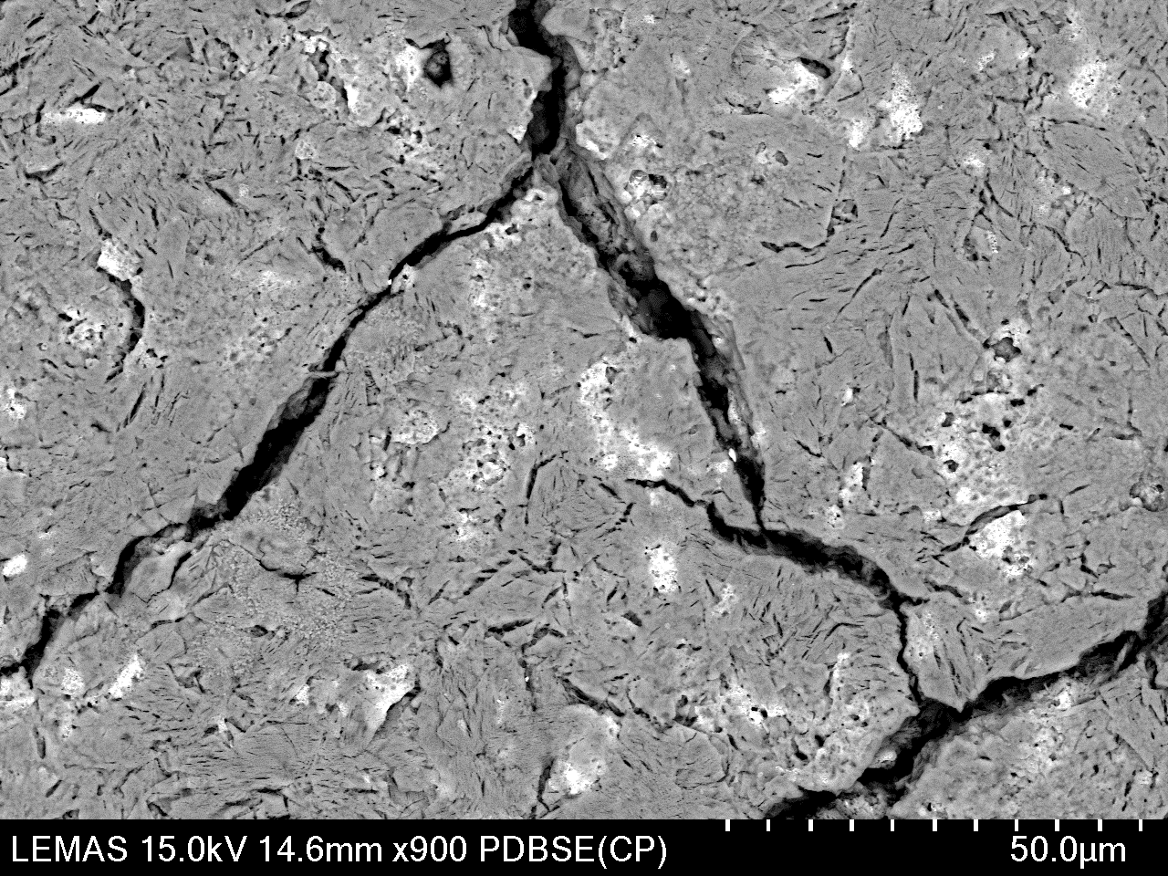

Slide 7
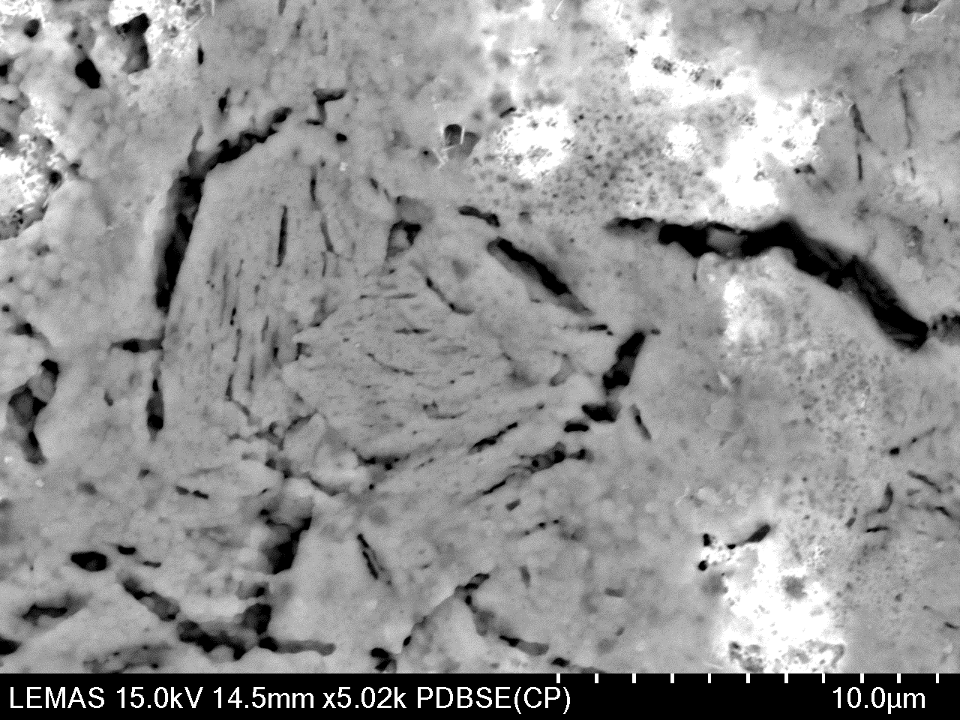

Slide 8
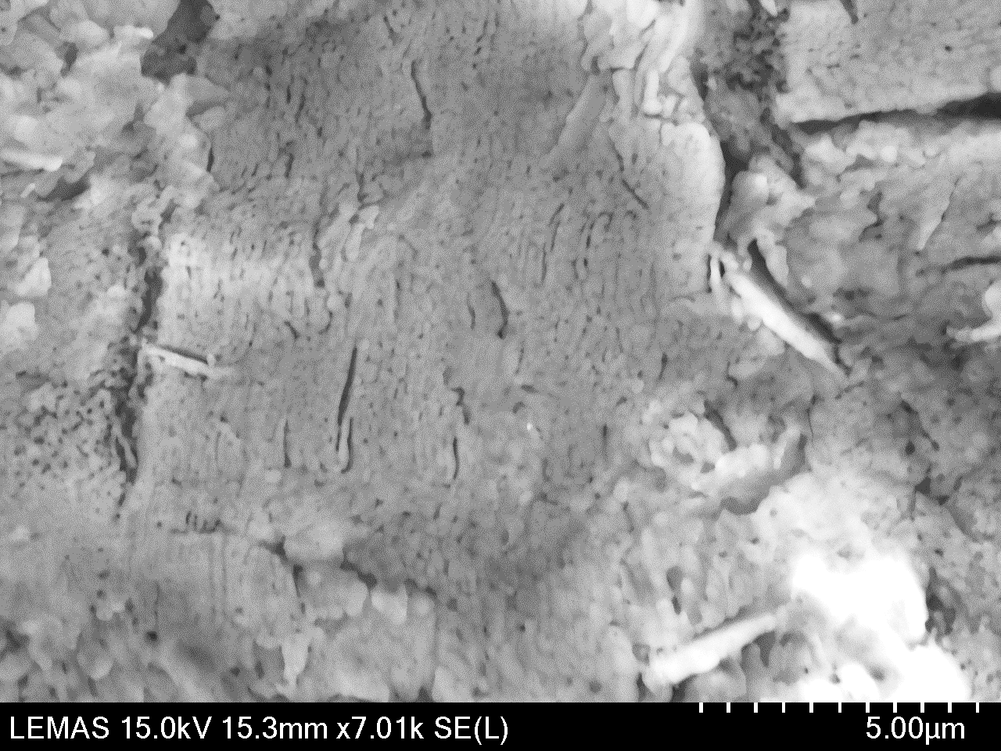

Slide 9
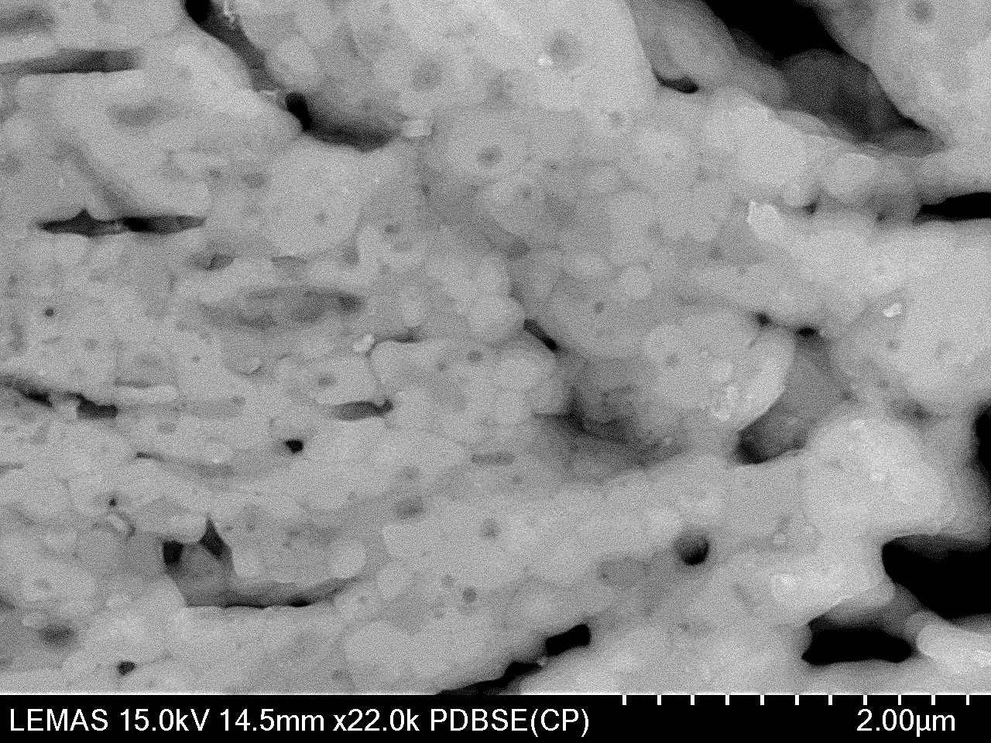

Slide 10
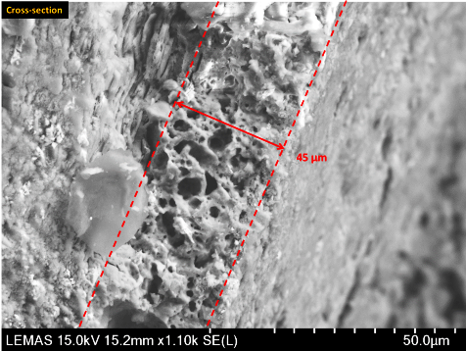

Slide 11
Sample 3: Brushite pellet
Diameter: 13 mm
Thickness: 1.10 mm
Irradiation parameters
Spot size | 30 | μm
Average power | 0.4 | W
Repetition rate | 1 | KHz
Pulse duration | 100 | fs
Wavelength | 800 | nm

Slide 15
Cross section

Slide 16
Sample 4: Coated enamel block
Orthosilicate gel mixed with brushite crystals
Thickness of the coating : 15 μm
Irradiation parameters
Spot size | 30 | μm
Average power | 0.4 | W
Repetition rate | 1 | KHz
Pulse duration | 100 | fs
Wavelength | 800 | nm

Slide 18
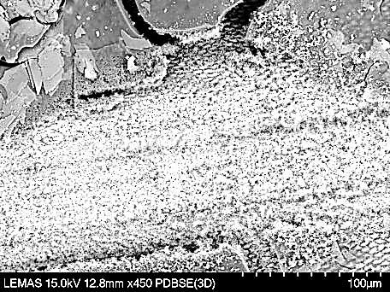

Slide 19
Sample 5: Coated enamel block
Orthosilicate gel mixed with brushite crystals
Thickness of the coating : 5 μm

Slide 20
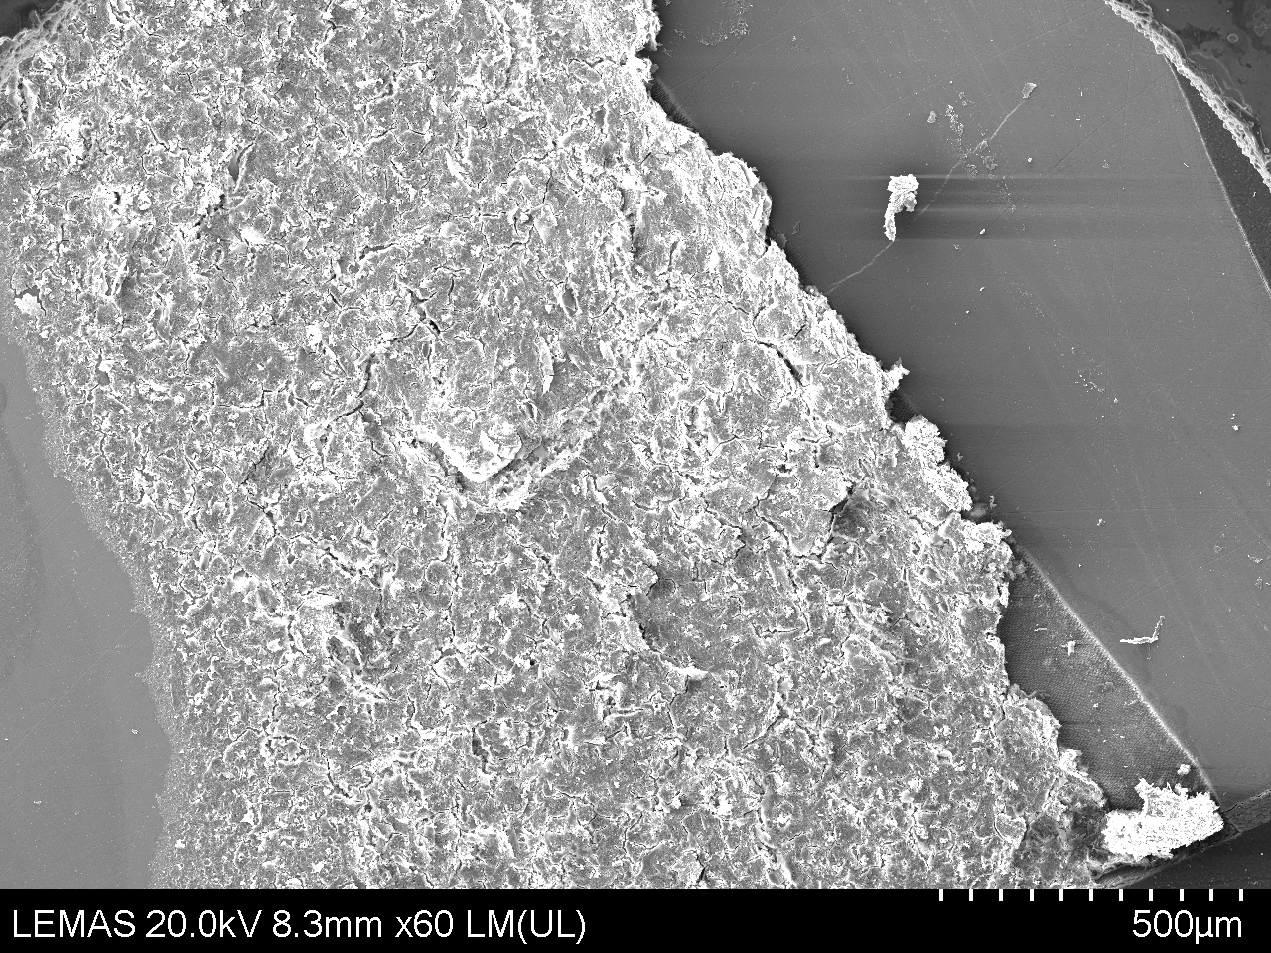

Slide 21
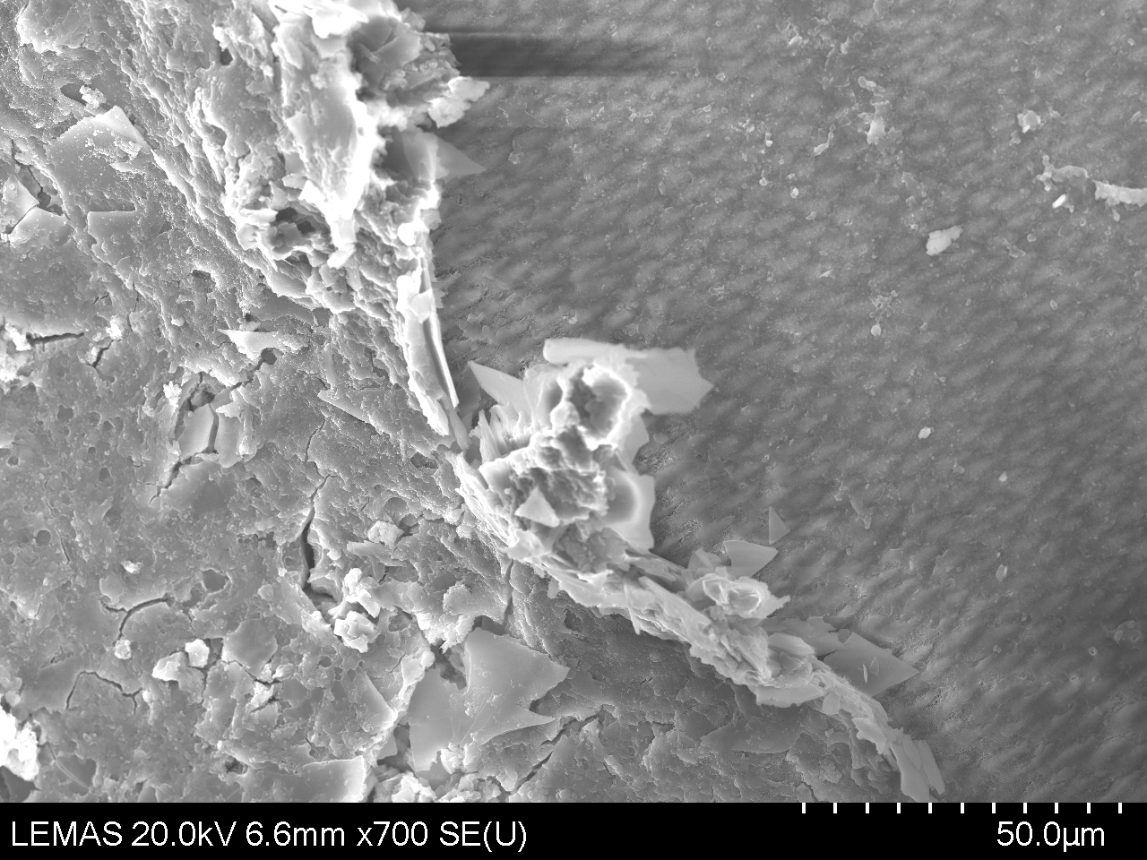

Slide 23
Sample 6: Coated enamel block
Orthosilicate gel mixed with brushite crystals
Thickness of the coating : 21 μm
Irradiation parameters
Spot size | 30 | μm
Average power | 0.4 | W
Repetition rate | 1 | GHz
Pulse duration | 100 | fs
Wavelength | 1050 | nm

Slide 24
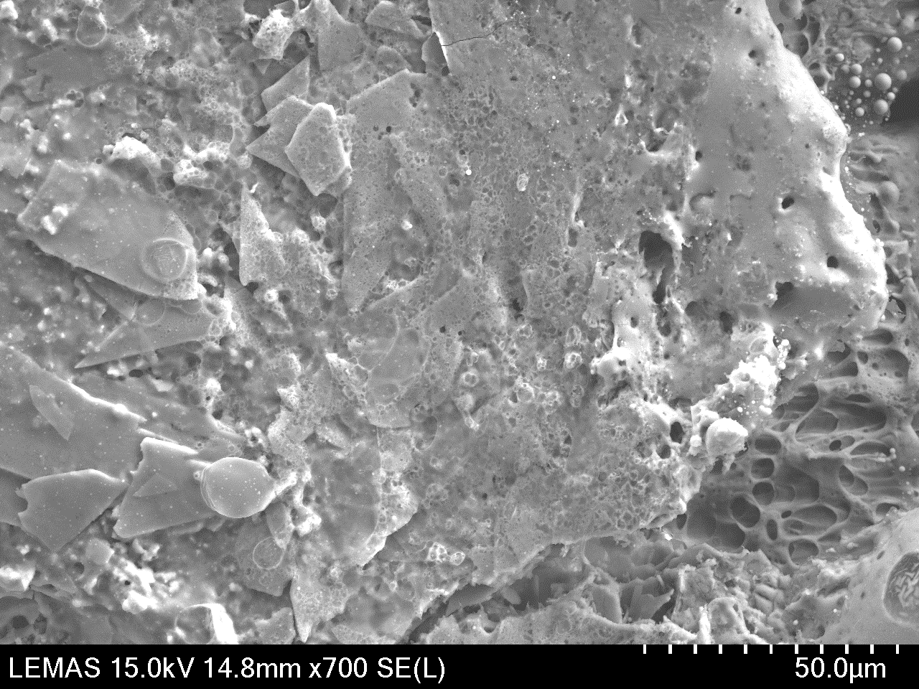

Slide 25
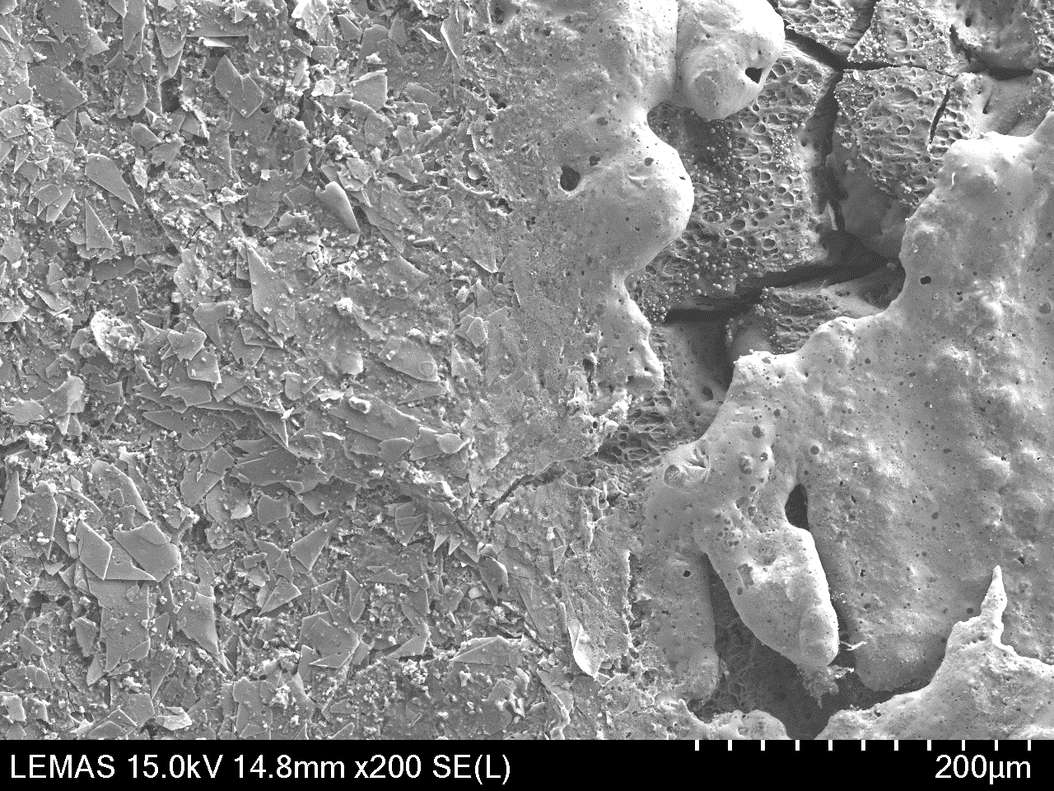

Slide 26
