Slide 1








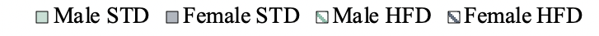
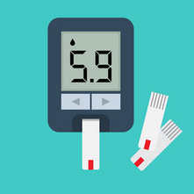
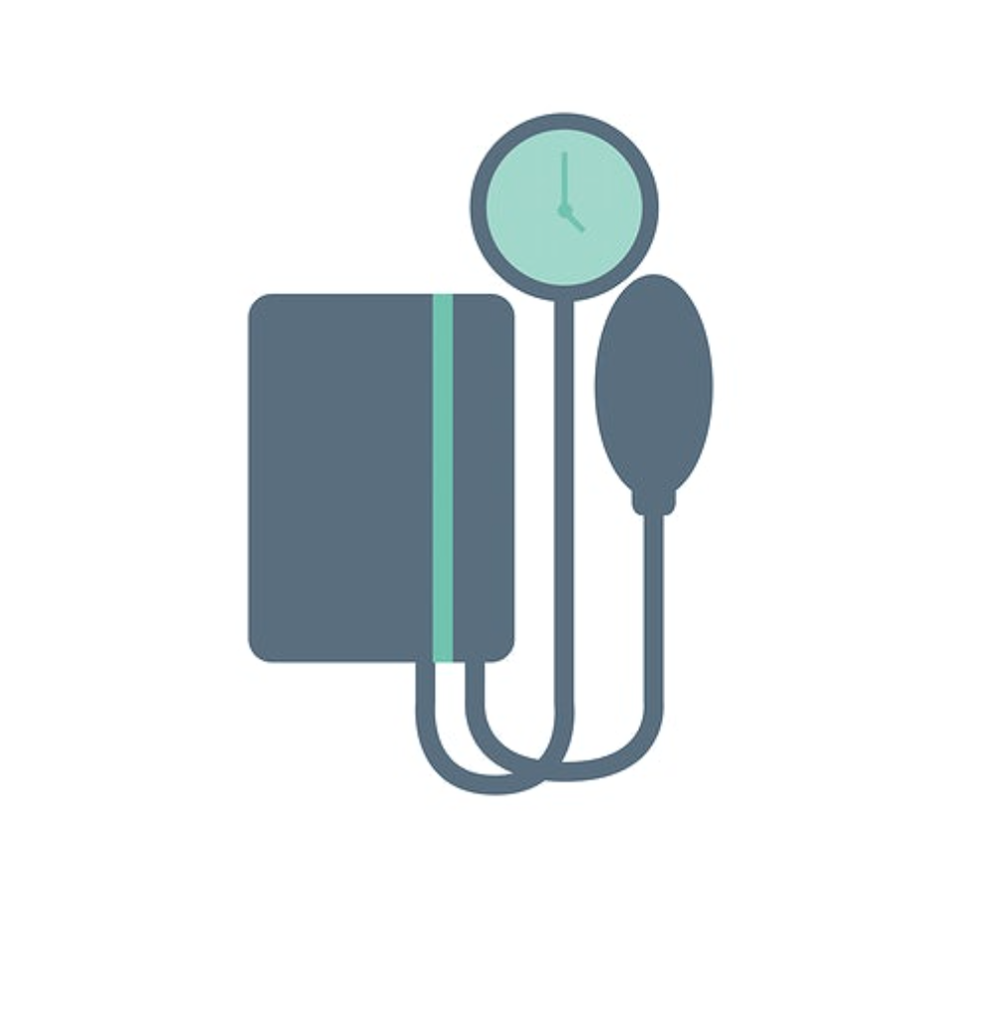


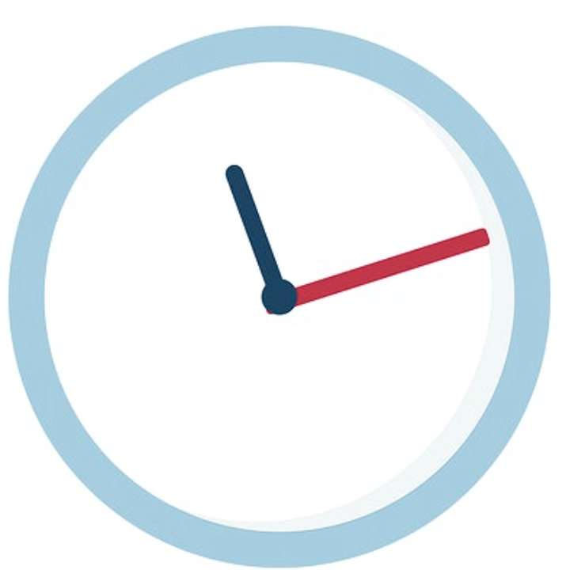




Sexism of Fat: Is it sufficient to use only one sex in obesity research?
Amanda MacCannell, Anna Whitehead, Amy Moran and Dr. Lee Roberts
Discovery and Translational Science, University of Leeds, Leeds, United Kingdom
2
WHAT WE KNOW:
4
WHAT WE LEARNED:
Males gain weight faster than females
64% of the UK population is overweight and 29% of adults are classed as obese¹.
Men and women respond to obesity differently.
In the UK men are 2X more likely to have diabetes³.
1
THE PROBLEM:
CAUSE OF OBESITY:
Figure 1. Male mice fed HFD increase their body mass after 1 week and females take 9 weeks.
Stress
Overeating
Medication
The UK has the highest rates of obesity in Europe¹.
In the UK 27% of men and 30% of women are obese².
Women deposit fat below the skin, men deposit fat around their organs².
Males are more susceptible to diabetes
HFD reduces metabolic differences
CONSEQUENCE OF OBESITY:
From the lab to the clinic
***
***
Animal models are used to study the effects and treatments for obesity and associated disease.
*
Diabetes
Heart disease
High blood pressure
3
WHAT WE DID:
Males and females present differently in the clinic, yet it is common to only use one sex in mouse studies.
Figure 2. Male mice fed high fat diet have increased glucose intolerance compared to female mice.
Figure 3. Male mice loose increased metabolic differences when fed high fat diet.
Male AND female mice
All data is presented as mean ± SEM, n = 10,* P < 0.05, *** P < 0.0001.
Conclusion:
Half the cost
Less time
Efficiency
Fed standard mouse food OR a High Fat Diet (HFD), like eating fast food every day.
Is it sufficient to use only one sex in obesity research?
Standard chow
High Fat Diet
The increased weight gain and glucose intolerance in males might be caused by changes in metabolism.
5
SIGNIFICANCE:
References:
1. Agha M. and Agha R., The Rising Prevalence of Obesity: Impact on Public Health. (2017) Int J Surg Oncol
2. Power ML, Schulkin J. Sex differences in fat storage, fat metabolism, and the health risks from obesity: possible evolutionary origins. (2008) Br J Nutr 4
3. https://www.diabetes.org
.uk/about_us/news_landing_page/middle-aged-men-twice-as-likely-to-have-diabetes-as-women
1) Measured blood glucose to detect diabetes.
1
2
It is NOT sufficient to use only one sex in obesity studies. Using both sexes in research will increase translation from lab to clinic.
&
2) Measured metabolic differences.

